Slide 1
AI-driven precision
agriculture and crop management system.

Slide 2
Project Objective.
The project's objective is to create an AI-driven agricultural solution that addresses global concerns related to food availability, sustainability, and food security. It aims to harness the power of AI and data analytics to optimize resource allocation, predict crop yields, and recommend sustainable farming practices, ultimately contributing to a more efficient, environmentally friendly, and secure food production system.

Slide 3
Why AI in Agriculture?
(AI in Precision Agriculture)
Big Data Handling
User-Friendly Interfaces
Data-Driven Decision Making
Crop Monitoring and Management
Sustainability Solutions
Machine Learning Algorithms
IoT Integration
Climate Modeling and Adaptation
Precision Agriculture Tools

Slide 4

"Our solution harnesses advanced AI and data analytics to empower farmers with precise resource allocation, accurate crop yield predictions, and sustainable farming recommendations. By leveraging cutting-edge technology, we aim to secure food production, reduce waste, and promote eco-friendly practices for a more sustainable future."
The solution

Slide 5
Flow for an Improved Crop Yield.
Farmer will login to the mobile App which will turn on the location.
The current crop condition will be displayed along with the soil type, the soil nutrients and soil moisture.
Remedies will be provided with instruction sets and frequency of tasks along with the links to the product website.
1
3
5
2
4
6
The datasets of precipitation rate, wind speed, soil nutrients composition , previous crop yield will be compared for the given geological location
A separate chart of what soil/ crop currently requires/demands will be provided.
Products that will be listed will be designed keeping in mind the Sustainable Farming Practices.

Slide 6
How to proceed?
Collect Dataset <weather pattern><soil condition><crop health><market demand>
Combine Datasets.
Recommend methods to improve Crop Yield .
Propose solutions .
Direct to product buy places if mentioned and demanded. Govt or company owned.
We can further compare various online sites for prices(URL”s) and choose the most convenient option.
Conduct EDA to gain insights from the integrated dataset. Visualize data using plots and graphs to identify trends, correlations, and patterns. This step will help you understand the relationships between weather, soil, crop health, and market demand.

Slide 7
Understanding the problems.
01
What About the Dataset?
>> extracting .csv files from authentic sources that include Kaggle and data.gov.in. another data manipulation Libraries used include- numpy , pandas , sklearn , plotly , matplotlib , etc.
02
Data Exploration and Analysis: Once you have merged the datasets into a single DataFrame, you can proceed with data exploration, analysis, and any other tasks you need to perform.
03
Crop Recommendation and proposed solution to improve crop yield?
AI in agriculture provides personalized crop advice, real-time monitoring, disease prediction, and yield estimation. Solutions like smart irrigation, automated harvesting, and knowledge-sharing platforms promote sustainable farming and increased yields.
Deploy your solution on the chosen platform (e.g., cloud server, web hosting)

Slide 8
Precision Farming
Drones in AI agriculture empower farmers with real-time, actionable insights, enabling them to make informed decisions. This integration of AI and drones optimizes agricultural processes, reduces costs, conserves resources, and ultimately enhances productivity and sustainability in farming practices.
IoT sensors in AI agriculture empower farmers with real-time, granular data that forms the basis for intelligent decision-making. By integrating IoT sensors and AI technologies, farmers can optimize their agricultural practices, enhance crop yield, conserve resources, and promote sustainable and environmentally friendly farming techniques.
AI in agriculture enhances productivity, reduces environmental impact, optimizes resource usage, and fosters sustainable farming practices. Its ability to process vast amounts of data and provide valuable insights empowers farmers, enabling them to make informed decisions and ultimately improving global food security.
AI and drones offer real-time insights; IoT sensors provide granular data. Integration optimizes farming, enhances productivity, conserves resources, and ensures sustainability.

Slide 9
Product Prototype
Input Selection:
District
Soil Color
Soil Properties
Recommendation Generation:
Machine Learning Model
Dynamic Options
Output Display
Recommended Crop
Recommended Fertilizer
Additional Information:
User Interaction: Train Model Button
Feedback Mechanism:
Provides personalized recommendations for Crop selection
Fertilizer usage based on user-input soil
Based on Properties and location
Technologies Used:
Python: For backend logic and machine learning model training.
Scikit-Learn: For machine learning algorithms and data processing.
Pandas: For data manipulation and analysis.
Jupyter Widgets: For interactive user interface components.
Matplotlib: For data visualization

Slide 10
Enhanced Predictive Analytics: Future AI models will become even more accurate in predicting crop yields, diseases, and pest infestations, enabling farmers to take proactive measures.
Integration with IoT and Edge Computing: Enables real-time data collection and analysis on the farm, allowing for immediate decision-making and resource optimization.
Blockchain for Traceability: involves tracking and recording the journey of agricultural products from the farm to the consumer, ensuring transparency and accountability throughout the supply chain.
Personalized Farming.
Sustainability Focus: Sustainability will remain a central theme, with AI helping to reduce the environmental impact of agriculture through efficient resource use and sustainable practices.
Future Scope
Futuristic approach will include “Geographical locations” for precision. Input of location -> suitable crop yield improvement methods.
Saving the Model using Joblib. # Import the joblib library import joblib # Assuming 'reg' is your regression model, save it to a file joblib.dump(reg, 'regression_model.pkl')
DRONE
IOT Sensors

Slide 11
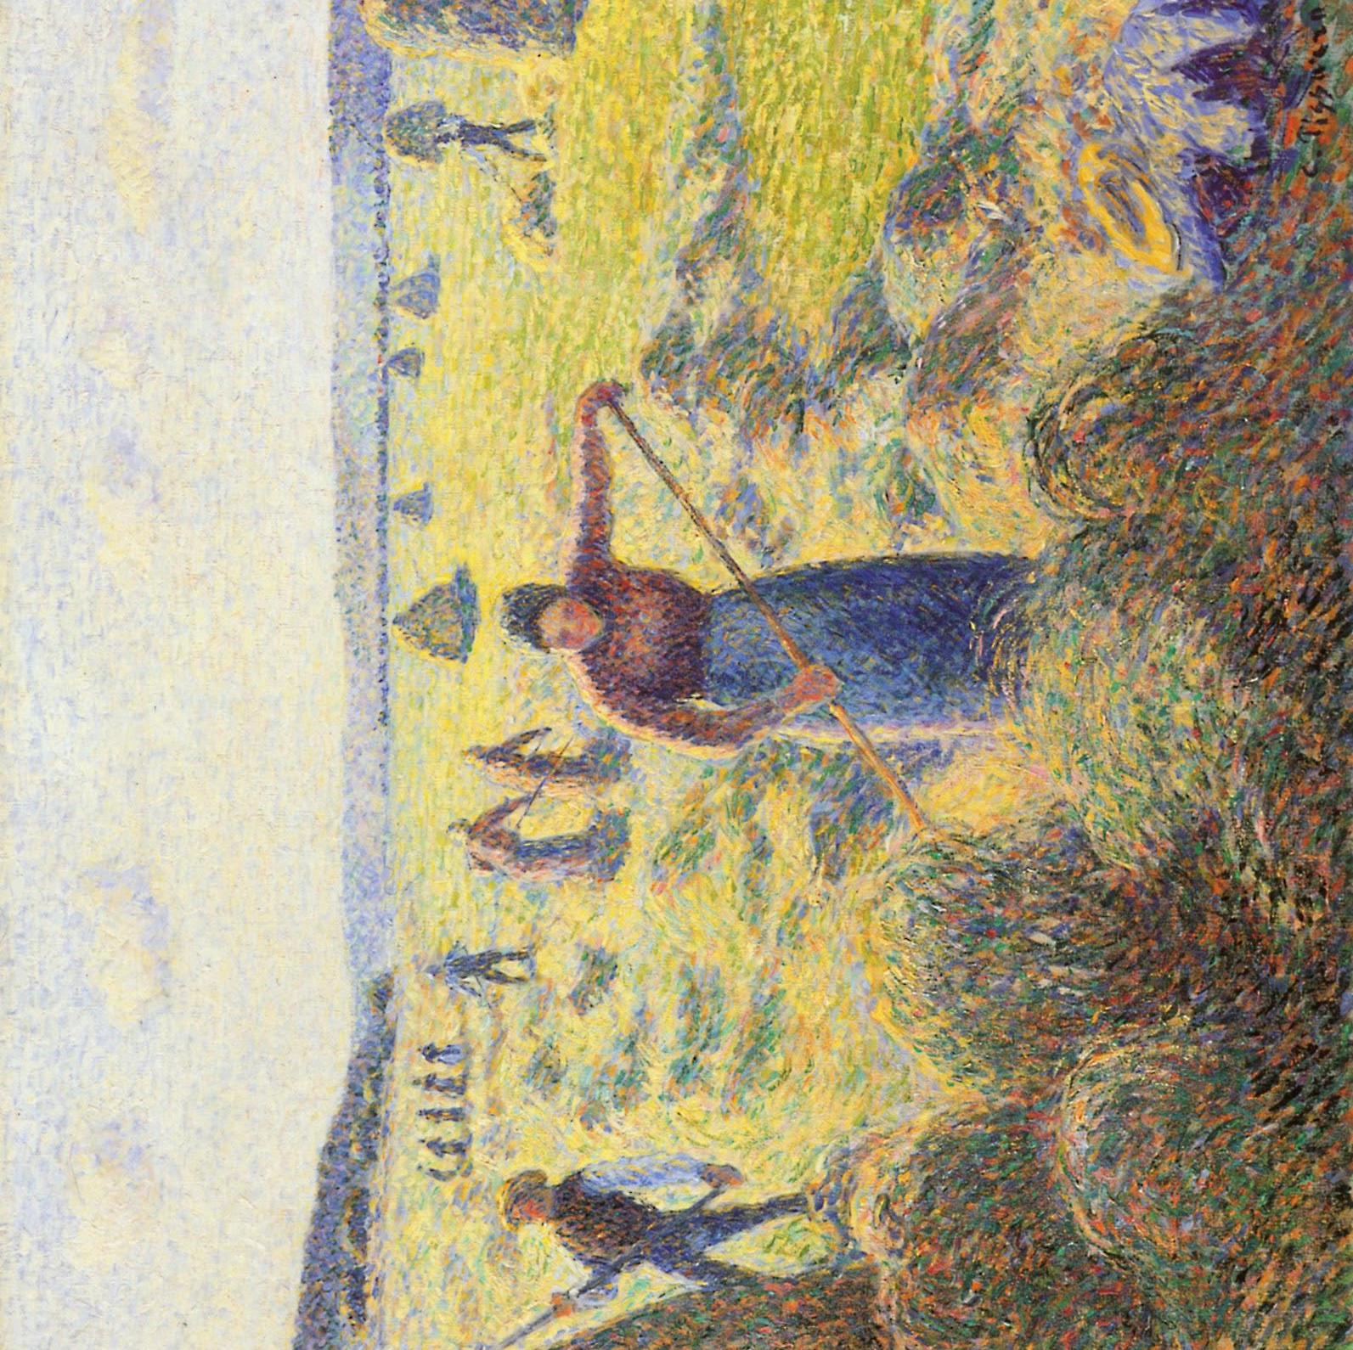
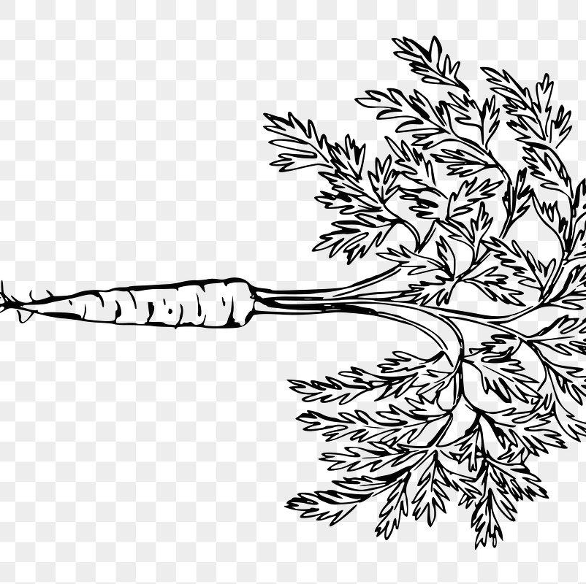
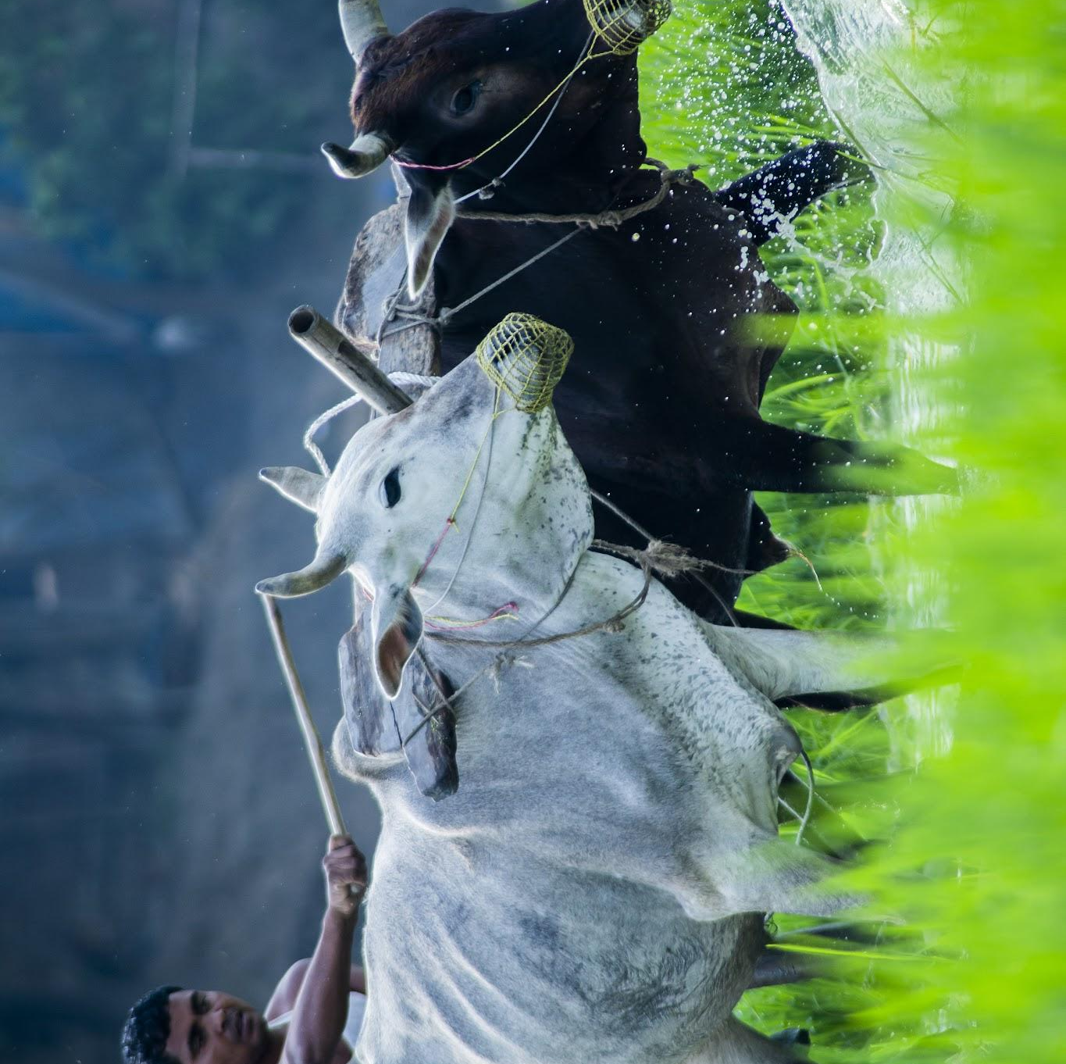
Business point of view.
Promotion and Outreach: Promote your solution to the target audience through various channels, such as agricultural associations, government agencies, and online platforms.
Money will be made by the implementing the following:
The app will direct to agricultural product selling sites after giving the appropriate solution for their soil.
The interactive app data of the user and AI is sold to product companies to work on marketing or selling of major required products and for them to understand the crop trend.
Advertising revenue
The service provided will be cost free for the farmers.

Slide 12
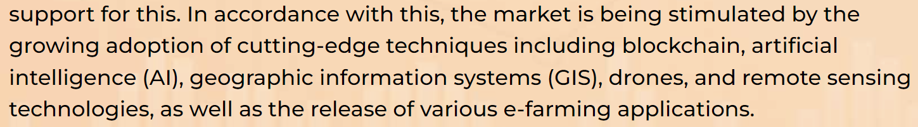
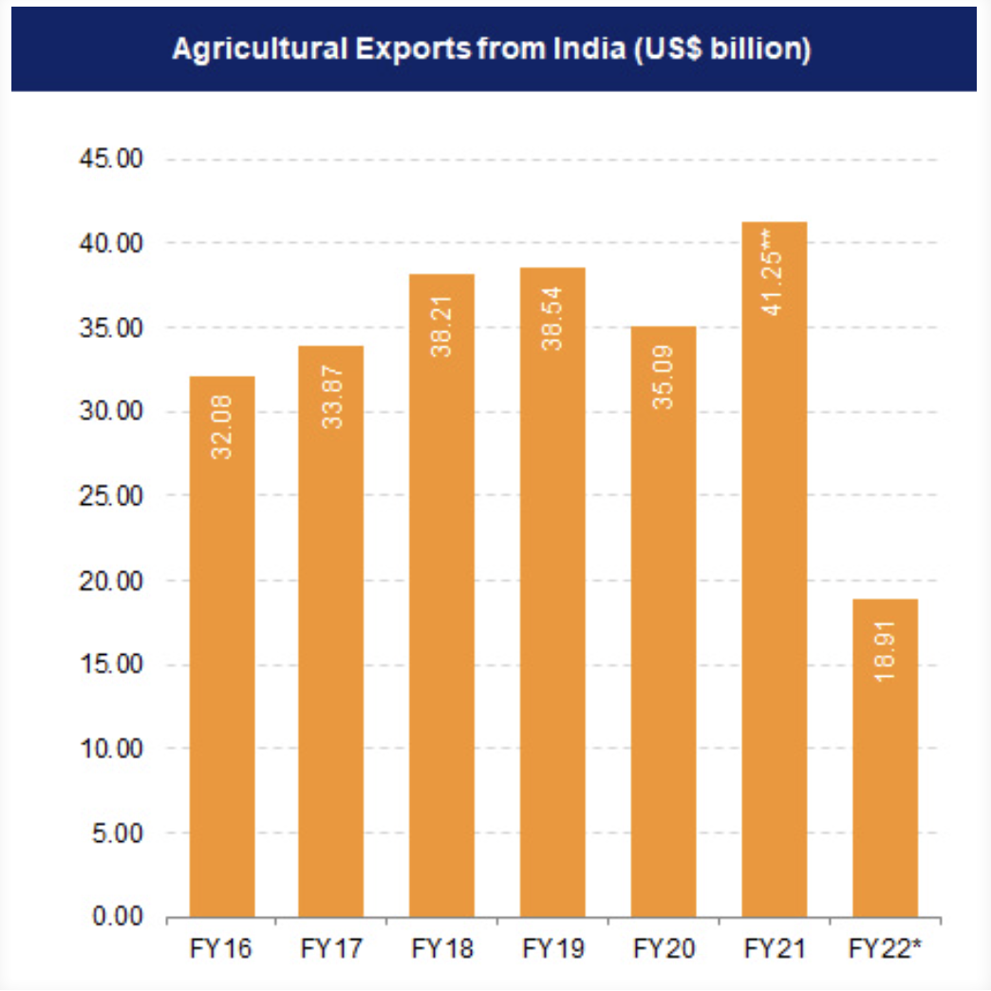
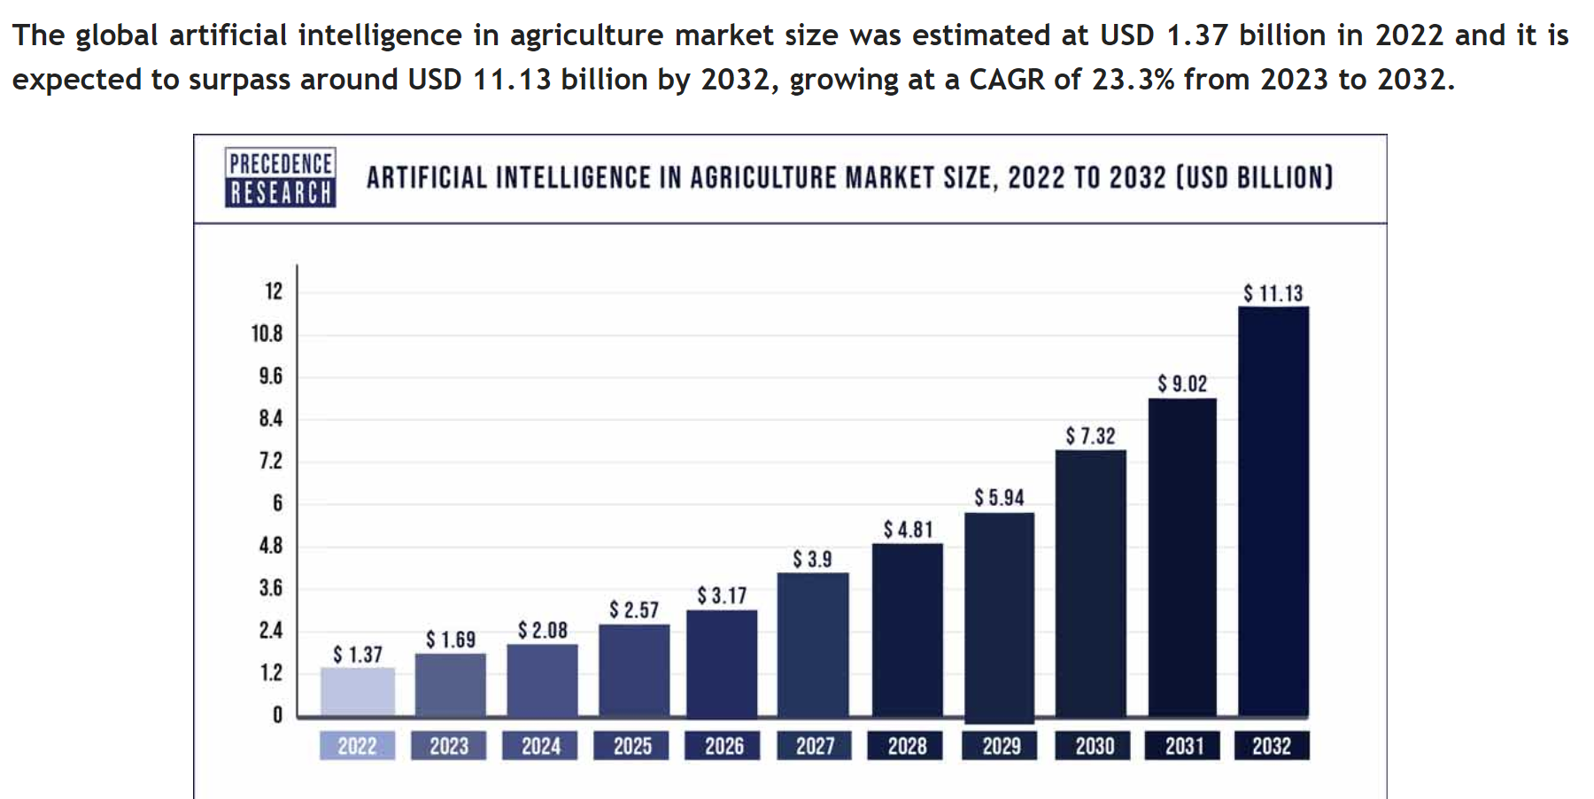
According to Inc42, the Indian agricultural sector is predicted to increase to US$ 24 billion by 2025. Indian food and grocery market is the world’s sixth largest, with retail contributing 70% of the sales. India’s agricultural and processed food products exports stood at US$ 43.37 billion in FY23 (April 2022-January 2023).
https://www.ibef.org/industry/agriculture-india
AI has the potential to increase crop yields by up to 70% while reducing water usage by 50%.
Market size and potential
The global artificial intelligence in agriculture market size was estimated at USD 1.37 billion in 2022 and it is expected to surpass around USD 11.13 billion by 2032, growing at a CAGR of 23.3% from 2023 to 2032.

Slide 13
Factors to Consider.
Feasibility
Complexity
Availability of high-quality agricultural data, including weather, soil, and crop yield information, is crucial but challenging to collect and integrate in some regions. Additionally, substantial technological infrastructure, such as sensors and IoT devices, is necessary, with feasibility varying based on location and available resources.
Precision agriculture, which involves analyzing various data sources such as weather patterns, soil conditions, and market demand, can be complex due to data diversity and requires advanced preprocessing and integration techniques. Developing accurate AI models for tasks like crop yield prediction and resource allocation adds complexity, as it involves choosing suitable algorithms and expert model training.
04
01
03
Practicability
Sustainability
The successful implementation of AI-driven precision agriculture relies on farmers' adoption and acceptance of the technology, necessitating training and support for effective use. Integration with existing farming practices and machinery must be seamless, minimizing disruptions. Furthermore, the solution's scalability is crucial, ensuring it can accommodate both small and large farms, along with diverse crop types.
The given text emphasizes the importance of integrating AI-driven practices in agriculture with sustainability considerations, ensuring long-term viability, and economic sustainability for farmers. These practices should focus on reducing resource consumption, conserving soil health, and mitigating climate change. It's crucial that AI recommendations do not deplete soil nutrients or harm ecosystems over time.
02

Slide 14
Revenue model
Advertising revenue
The service provided will be free for the farmers.
Hardware Sales or Leasing: If your solution includes IoT sensors, drones, or other hardware components, consider selling or leasing the hardware to users.
*providing them with adequate subsidy.
Data Licensing and Sales
E-Commerce Integration

Slide 15

Why now?
Competitive Advantage: Early adopters of AI-driven precision agriculture can gain a competitive advantage in the market of BHARAT by improving productivity and sustainability as there are no significant competitors.

Slide 16
Thank you!

